Slide 1

AUTOMATIC ATTENDANCE SYSTEM USING IMAGE PROCESSING
DEPARTMENT OF ELECTRONICS AND COMMUNICATION
MINI PROJECT PHASE II
Second Interim Presentation
ANUPAMA PT-KME20EC008
ERIN EDWARD GEORGE-KME20EC013
HANA VK-KME20EC015
NZ FADHIYA- KME20EC027
MR BINISH MC
ASSISTANT PROFESSOR
DEPARTMENT OF ECE

Slide 2
CONTENTS
INTRODUCTION
LITERATURE REVIEW
PROBLEM STATEMENT
OBJECTIVES
PROPOSED METHODOLOGY
BLOCK DIAGRAM
FLOW CHART
COST ESTIMATION OF PROJECT
PROJECT WORK DIVISION
ADVANTAGES AND DISADVANTAGES
CONCLUSION
REFERENCES

Slide 3
INTRODUCTION
Image processing is way of exploiting the images for our benefits.
In this project we are aiming at an automatic attendance marking system based on facial image recognition.
Firstly the data set is created for each person . Then the HAAR classifier segments the frontal face segments from it.
Now the LBPH compares the binary pattern of each facial segments and classify them into each training datasets.
During the testing phase the web cam turns ON and if it detects a person corresponding to the previously trained LPBH values then the attendance is marked for that respective person.
If the system recognizes faces, the attendance gets marked immediately of respective recognized faces.

Slide 4
LITERATURE REVIEW
Title | Author | Publication | Methodology | Advantages | Limitations
Class Attendance Management System Using Face Recognition [1] | Omar Abdul Rhman Salim Et al. (2018) | IEEE | Local Binary Patterns algorithm. | It has better data accuracy. It is time efficient. It is portable which makes it handy | light sensitivity
Facial Detection and Recognition using OpenCV on Raspberry Pi Zero[2] | Gagandeep Singh Nagpal Et al. (2018) | IEEE | Local Binary Pattern Histogram | It takes Less time to detect face in captured image. Portable and compact. | Light sensitivity
Deep-learning based group-photo Attendance System using One Shot Learning[3] | Dr Aruna Bhat Et al. (2020) | IEEE | Multi Task Convolution Neural Network | Robust Efficient User friendly | Costly, Not accurate always

Slide 5
LITERATURE REVIEW
Title | Author | Publication | Methodology | Advantages | Limitations
Face Recognition-Based Mobile Automatic Classroom Attendance Management System[4] | Refik Samet Muhammed Tanriverdi (2017) | IEEE | Local Binary Pattern | Time efficiency Portable | Decreased success with increasing distance between the camera and students Illumination affects
Attendance System Based on Face Recognition System Using CNN-PCA Method and Real-time Camera [5] | Edy Winarno Et al. (2019) | IEEE | Convolutional Neural Network - Principal Component Analysis | More accurate It is time efficient. It is portable Reliable | It is costly.

Slide 6
LITERATURE REVIEW
Title | Author | Publication | Methodology | Advantages | Limitations
FaceTime – Deep Learning Based Face Recognition Attendance System[6] | Marko Arsenvoic Et al. (2017) | IEEE | Convolution Neural Network | Reliable Efficient Simple Time Saving Easy | Light sensitivity Noise sensitivity Not accurate
Facial Recognition using Machine Learning Algorithms on Raspberry Pi[7] | Seema Singh Et al. (2019) | IEEE | Haar Cascade HOG | High detection speed. Reliability and accuracy. Real time implementation. | Change in luminosity. Occluded faces False predictions.
Facial Detection and Recognition System on Raspberry pi with Enhanced Security[8] | D. Sri Sai Mahesh Et al.(2020) | IEEE | OpenCV Face Recognition | Good feature extraction Enhancement in security | Costly Not accurate

Slide 7
LITERATURE REVIEW
Title | Author | Publication | Methodology | Advantages | Limitations
Automated Attendance System using Machine Learning Approach[9] | Hemanthkumar Rathod Et al. (2017) | IEEE | Histogram of Orientated Gradients(HOG) | Its makes easy calculation of attendence | It is costly Light sensitivity
Face Recognition for Student Attendence using Raspberry Pi[10] | A. S. Hasban Et al.(2019) | IEEE | Facial Recognition | Simple to manufacture Calculates presence of students and marks the attendance. | Poor image quality
Joint Face Detection and Alignment using Multitask Cascaded Convolutional Networks[11] | Kaipeng Zhang Et al. (2016) | ​IEEE | Convolutional neural networks (CNN) | Ability to detect faces​ Better run time efficiency | It is Costly

Slide 8
PROBLEM STATEMENT
Every school, colleges, or library mandatorily takes attendance and is always recorded.
The normal practices are the teacher calling out the names of students or roll numbers to which the respective students respond.
Inaccuracy to the results and time consumption further adds on to the problem.
To ease out this situation an automatic attendance system can monitor the students using facial recognition and their attendance will be marked automatically.

Slide 9
OBJECTIVES
To develop a portable smart attendance system.
To ensure the speed of the attendance recording process is faster than the previous system.
Able to recognize the face of an individual accurately based on the face database.
Develop a database for the attendance management system.
Able to show an indication to the user whether the face- recognition process is successful or not.

Slide 10
PROPOSED METHODOLOGY
The system consists of a camera which captures an image
The proposed methodology is Face detection using OpenCV and classification using HAAR Cascade method
The LBPH Algorithm creates a training dataset using pattern recognition
The faces are detected from the input image and the algorithm compares them one by one with the face database

Slide 11
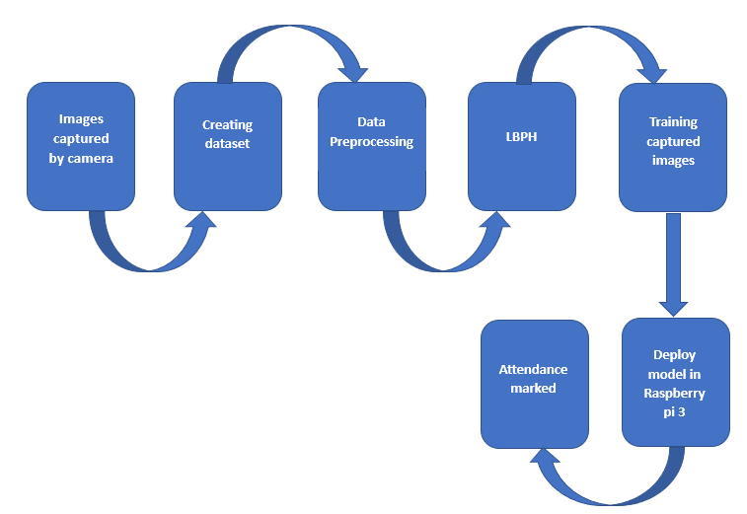
BLOCK DIAGRAM
Power Supply
Raspberry Pi
Camera Module
Fig : 1.1

Slide 12
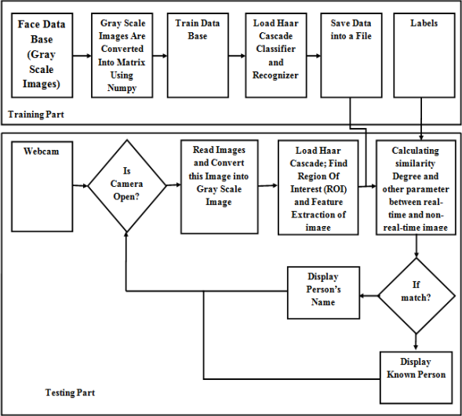
FLOWCHART
Fig : 1.2[12]

Slide 13
COST ESTIMATION OF THE PROJECT
COMPONENTS | COST
Raspberry Pi | ₹9000
Adapter | ₹695
Class 10 micro SD card | ₹369
HDMI to VGA cable | ₹209
TOTAL COST | ₹10273

Slide 14
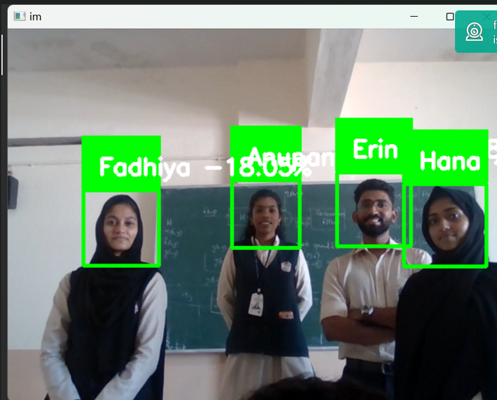

RESULT
Successfully identified multiple faces using HAAR Cascade classifier.
Accuracy level of 70%
Fig : 1.3

Slide 15
PROJECT WORK DIVISION
STUDENT NAME | Works done for project
Erin Edward George | PPT preparation, coding, report
Hana V K | PPT preparation, report, coding
Anupama P T | PPT preparation, base papers, coding
N Z Fadhiya | PPT preparation, report, coding

Slide 16
ADVANTAGES
DISADVANTAGES
HAAR Cascade frontal face
Fast and efficient
Robust
Easy to use
LBPH
Robust to variations
Simplicity
Efficiency
HAAR Cascade frontal face
Limited to frontal faces
Sensitive to occlusions
False positives/negatives
LBPH
Limited discriminated power
Sensitive to noise
Training requirements

Slide 17
CONCLUSION
Using face recognition technology in attendance systems can offer several benefits over traditional methods such as manual or barcode scanning methods.
By leveraging computer vision and machine learning algorithms, face recognition technology can accurately identify individuals and record their attendance automatically
In conclusion, the implementation of attendance by face recognition using Python can significantly improve the accuracy, speed, and convenience of attendance tracking.

Slide 18
REFERENCES
[1]2018 7th International Conference on Computer and Communication Engineering (ICCCE)
[2]International Conference on advances in Computing, Communication Control and Networking 2018
[3]Proceedings of the International Conference on Electronics and Sustainable Communication Systems (ICESC 2020) IEEE Xplore Part Number: CFP20V66-ART; ISBN: 978-1-7281-4108-4
[4]2017 International Conference on Cyberworlds
[5]2019 International Seminar on Research of Information Technology and Intelligent Systems (ISRITI)
[6]SISY 2017 • IEEE 15th International Symposium on Intelligent Systems and Informatics • September 14-16, 2017 • Subotica, Serbia
[7]2019 4th Internationl Conference on Electrical, Electronics , Communication , Computer Technologies and Optimization Techniques.
[8]2020 International Conference on Emerging Trends in Information Technology and Engineering
[9]2017 International Conference on Nascent Technologies in the Engineering Field
[10]2019 IEEE Asia –Pacafic Conference on applied Electromagnetics
[11]IEEE signal Processing Letters, VOL. 23,NO. 10,OCTOBER 2016
[12] Zankruti Arya, et. al. International Journal of Engineering Research and Applications

Slide 19
THANK YOU

